Slide 1
CSE 225
Prefix, Postfix and Infix Notation

Slide 2
Infix Notation
To add A, B, we write
A+B
To multiply A, B, we write
A*B
The operators ('+' and '*') go in between the operands ('A' and 'B')
This is "Infix" notation.

Slide 3
Prefix Notation
Instead of saying "A plus B", we could say "add A,B " and write
+ A B
"Multiply A,B" would be written
* A B
This is Prefix notation.

Slide 4
Postfix Notation
Another alternative is to put the operators after the operands as in
A B +
and
A B *
This is Postfix notation.
Notes:
"A,B are multiplied"
"A,B are added"

Slide 5
Position of Operators
The terms infix, prefix, and postfix tell us whether the operators go between, before, or after the operands.
Pre A In B Post

Slide 6
Significance of Parentheses
Evaluate 2+3*5.
+ First:
(2+3)*5 = 5*5 = 25
* First:
2+(3*5) = 2+15 = 17
Infix notation requires Parentheses.

Slide 7
What about Prefix Notation?
+ 2 * 3 5 =
= + 2 * 3 5
= + 2 15 = 17
* + 2 3 5 =
= * + 2 3 5
= * 5 5 = 25
No parentheses needed!

Slide 8
Postfix Notation
2 3 5 * + =
= 2 3 5 * +
= 2 15 + = 17
2 3 + 5 * =
= 2 3 + 5 *
= 5 5 * = 25
No parentheses needed here either!

Slide 9
Summary on the Significance pf Parentheses
Infix is the only notation that requires parentheses in order to change the order in which the operations are done.

Slide 10
Fully Parenthesized Expression
A FPE has exactly one set of Parentheses enclosing each operator and its operands.
Which is fully parenthesized?
( A + B ) * C
( ( A + B) * C )
( ( A + B) * ( C ) )

Slide 11
Infix to Prefix Conversion
Move each operator to the left of its operands & remove the parentheses:
( ( A + B) * ( C + D ) )
Notes:
Start with Fully parenthesized expression. Move each operator to the left of its operands and remove the set of parentheses.

Slide 12
Infix to Prefix Conversion
Move each operator to the left of its operands & remove the parentheses:
( + A B * ( C + D ) )
Notes:
Start with Fully parenthesized expression. Move each operator to the left of its operands and remove the set of parentheses.

Slide 13
Infix to Prefix Conversion
Move each operator to the left of its operands & remove the parentheses:
* + A B ( C + D )
Notes:
Start with Fully parenthesized expression. Move each operator to the left of its operands and remove the set of parentheses.

Slide 14
Infix to Prefix Conversion
Move each operator to the left of its operands & remove the parentheses:
* + A B + C D
Order of operands does not change!
Notes:
Start with Fully parenthesized expression. Move each operator to the left of its operands and remove the set of parentheses.

Slide 15
Infix to Postfix
( ( ( A + B ) * C ) - ( ( D + E ) / F ) )
A B + C * D E + F / -
Operand order does not change!
Operators are in order of evaluation!

Slide 16
Computer Algorithm FPE Infix To Postfix
Assumptions:
Space delimited list of tokens represents a FPE infix expression
Operands are single characters.
Operators +,-,*,/

Slide 17
FPE Infix To Postfix
Initialize a Stack for operators, output list
Split the input into a list of tokens.
for each token (left to right):
if it is operand: append to output
if it is '(': push onto Stack
if it is ')': pop & append till '('

Slide 18
FPE Infix to Postfix
( ( ( A + B ) * ( C - E ) ) / ( F + G ) )
stack: <empty>
output: []

Slide 19
FPE Infix to Postfix
( ( A + B ) * ( C - E ) ) / ( F + G ) )
stack: (
output: []

Slide 20
FPE Infix to Postfix
( A + B ) * ( C - E ) ) / ( F + G ) )
stack: ( (
output: []

Slide 21
FPE Infix to Postfix
A + B ) * ( C - E ) ) / ( F + G ) )
stack: ( ( (
output: []

Slide 22
FPE Infix to Postfix
+ B ) * ( C - E ) ) / ( F + G ) )
stack: ( ( (
output: [A]

Slide 23
FPE Infix to Postfix
B ) * ( C - E ) ) / ( F + G ) )
stack: ( ( ( +
output: [A]

Slide 24
FPE Infix to Postfix
) * ( C - E ) ) / ( F + G ) )
stack: ( ( ( +
output: [A B]

Slide 25
FPE Infix to Postfix
* ( C - E ) ) / ( F + G ) )
stack: ( (
output: [A B + ]

Slide 26
FPE Infix to Postfix
( C - E ) ) / ( F + G ) )
stack: ( ( *
output: [A B + ]

Slide 27
FPE Infix to Postfix
C - E ) ) / ( F + G ) )
stack: ( ( * (
output: [A B + ]

Slide 28
FPE Infix to Postfix
- E ) ) / ( F + G ) )
stack: ( ( * (
output: [A B + C ]

Slide 29
FPE Infix to Postfix
E ) ) / ( F + G ) )
stack: ( ( * ( -
output: [A B + C ]

Slide 30
FPE Infix to Postfix
) ) / ( F + G ) )
stack: ( ( * ( -
output: [A B + C E ]

Slide 31
FPE Infix to Postfix
) / ( F + G ) )
stack: ( ( *
output: [A B + C E - ]

Slide 32
FPE Infix to Postfix
/ ( F + G ) )
stack: (
output: [A B + C E - * ]

Slide 33
FPE Infix to Postfix
( F + G ) )
stack: ( /
output: [A B + C E - * ]

Slide 34
FPE Infix to Postfix
F + G ) )
stack: ( / (
output: [A B + C E - * ]

Slide 35
FPE Infix to Postfix
+ G ) )
stack: ( / (
output: [A B + C E - * F ]

Slide 36
FPE Infix to Postfix
G ) )
stack: ( / ( +
output: [A B + C E - * F ]

Slide 37
FPE Infix to Postfix
) )
stack: ( / ( +
output: [A B + C E - * F G ]

Slide 38
FPE Infix to Postfix
)
stack: ( /
output: [A B + C E - * F G + ]

Slide 39
FPE Infix to Postfix
stack: <empty>
output: [A B + C E - * F G + / ]

Slide 40
Problem with FPE
Too many parentheses.
Establish precedence rules:
My Dear Aunt Sally
We can alter the previous program to use the precedence rules.

Slide 41









Slide 42









Slide 43









Slide 44










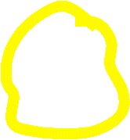


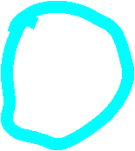





Slide 45















Slide 46



















Slide 47



Infix to Postfix
Initialize a Stack for operators, output list
Split the input into a list of tokens.
for each token (left to right):
if it is operand: append to output
if it is '(': push onto Stack
if it is ')': pop & append till '('
if it in '+-*/':
while peek has precedence ≥ it:
pop & append
push onto Stack
pop and append the rest of the Stack.

Slide 48






Slide 49







Slide 50
Contin…..
Conversion of Infix to Postfix
Example to Convert Infix to Postfix using stack
a + (b*c)
Read character | Stack | Output
a | Empty | a
+ | + | a
( | +( | a
b | +( | ab
* | +(* | ab
c | +(* | abc
) | + | abc*
 |  | abc*+

Slide 51
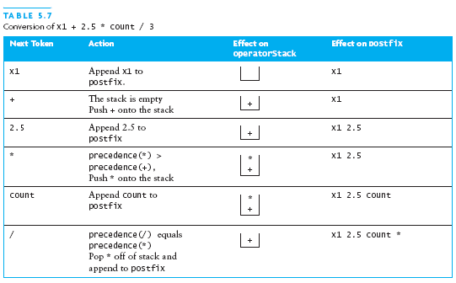
Contin…..
Conversion of Infix to Postfix

Slide 52
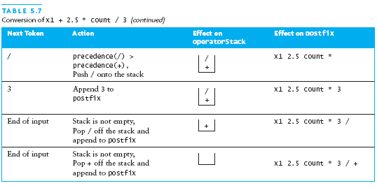
Contin…..
Conversion of Infix to Postfix

Slide 53
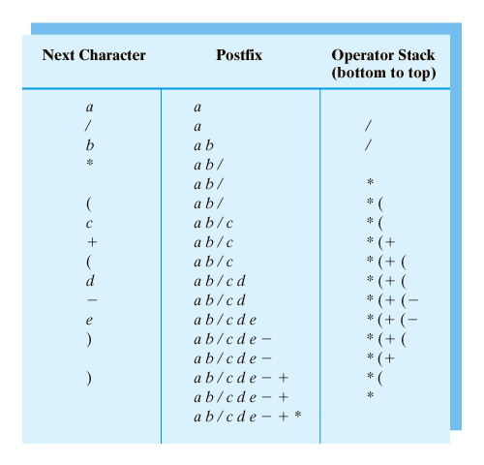
Contin…..
Conversion of Infix to Postfix

Slide 54



Exercise
Explain how to convert an infix expression to postfix expression?
Convert the following infix expression to postfix expression?
(a) (a + b*c) / (c - d)
(b) a/ (b + c)+ d * (e - f)
Explain an algorithm for converting to infix postfix?

Slide 55
a/ (b + c)+ d * (e - f)

Slide 56

a/ (b + c)+ d * (e - f)

Slide 57

































Slide 58
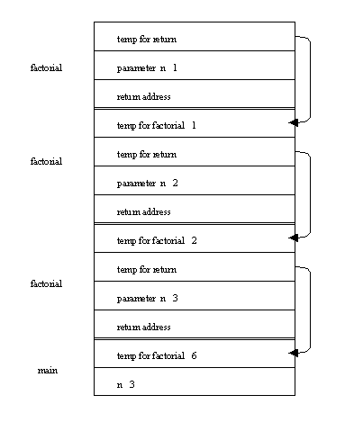

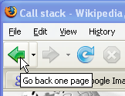
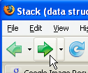
Uses of Stacks
The runtime stack used by a process (running program) to keep track of methods in progress
Search problems
Undo, redo, back, forward

Slide 59
Algorithm for Infix to Postfix
1) Examine the next element in the input.
2) If it is operand, output it.
3) If it is opening parenthesis, push it on stack.
4) If it is an operator, then
i) If stack is empty, push operator on stack.
ii) If the top of stack is opening parenthesis, push operator on stack
iii) If it has higher priority than the top of stack, push operator on stack.
iv) Else pop the operator from the stack and output it, repeat step 4
5) If it is a closing parenthesis, pop operators from stack and output them until an opening parenthesis is encountered. pop and discard the opening parenthesis.
6) If there is more input go to step 1
7) If there is no more input, pop the remaining operators to output.

Slide 60
Evaluation a postfix expression
Each operator in a postfix string refers to the previous two operands in the string.
Suppose that each time we read an operand we push it into a stack. When we reach an operator, its operands will then be top two elements on the stack
We can then pop these two elements, perform the indicated operation on them, and push the result on the stack.
So that it will be available for use as an operand of the next operator.

Slide 61
Evaluating Postfix Notation
Use a stack to evaluate an expression in postfix notation.
The postfix expression to be evaluated is scanned from left to right.
Variables or constants are pushed onto the stack.
When an operator is encountered, the indicated action is performed using the top elements of the stack, and the result replaces the operands on the stack.

Slide 62
Evaluating a postfix expression
Initialise an empty stack
While token remain in the input stream
Read next token
If token is a number, push it into the stack
Else, if token is an operator, pop top two tokens off the stack,apply the operator, and push the answer back into the stack
Pop the answer off the stack.

Slide 63







Slide 64








Slide 65
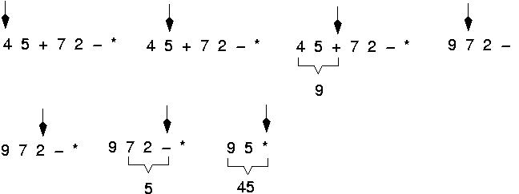
Example: postfix expressions (cont.)

Slide 66
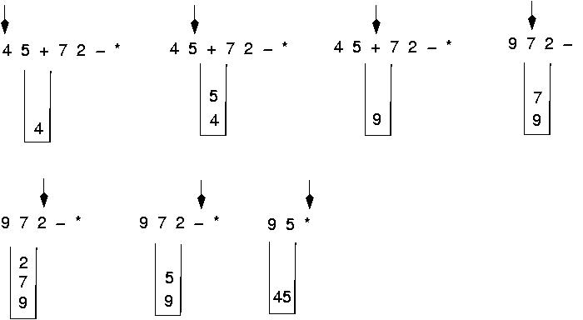
Postfix expressions: Algorithm using stacks (cont.)

Slide 67


Algorithm for evaluating a postfix expression (Cond.)
WHILE more input items exist
{
If symb is an operand
then push (opndstk,symb)
else //symbol is an operator
{
Opnd2=pop(opndstk);
Opnd1=pop(opndnstk);
Value = result of applying symb to opnd1 & opnd2
Push(opndstk,value);
} //End of else
} // end while
Result = pop (opndstk);

Slide 68


Question : Evaluate the following expression in postfix : 623+-382/+*2^3+
Final answer is
49
51
52
7
None of these

Slide 69
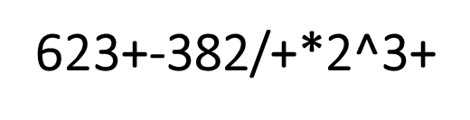


Slide 70
Evaluate- 623+-382/+*2^3+
Symbol opnd1 opnd2 value opndstk
6 6
2 6,2
3 6,2,3
+ 2 3 5 6,5
- 6 5 1 1
3 6 5 1 1,3

Slide 71

Evaluate- 623+-382/+*2^3+
Symbol opnd1 opnd2 value opndstk
8 6 5 1 1,3,8
2 6 5 1 1,3,8,2
/ 8 2 4 1,3,4
+ 3 4 7 1,7
* 1 7 7 7
2 1 7 7 7,2
^ 7 2 49 49
3 7 2 49 49,3
+ 49 3 52 52

